Slide 1
Power Management and Sleep Modes:
Power consumption is a critical issue for a device running continuously for a long time without being turned off. So, to overcome this problem almost every controller comes with a Sleep Mode, which helps developers to design electronic gadgets. Sleep mode puts the device in power-saving mode optimal power consumption by turning off the unused modules.
An Arduino Sleep mode is also referred to as Arduino Power Save Mode or Arduino Standby Mode.
Arduino UNO, Arduino Nano, and Pro-mini come with ATmega328P and it has a Brown-Out Detector (BOD), which monitors the supply voltage at the time of Sleep Mode.

Slide 2
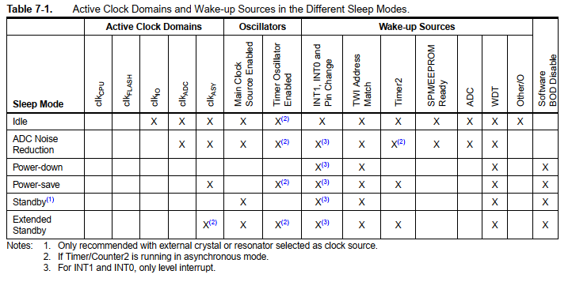
Power Management and Sleep Modes:
Sleep modes enable the application to shut down unused modules in the MCU, thereby saving power. The AVR provides various sleep modes allowing the user to tailor the power consumption to the application’s requirements. There are six sleep modes in ATmega328P:

Slide 3
Power Management and Sleep Modes:

Slide 4

Register Description:
SMCR – Sleep Mode Control Register
The Sleep Mode Control Register (SMCR) contains control bits for power management. The function of these bits (SM2:0) is shown in the next slide.
For entering into any of the sleep modes, we need to enable the sleep bit in the Sleep Mode Control Register (SMCR.SE). Then, the Sleep Mode Select bits select any 1 of the sleep modes among 6 different sleep modes, viz. Idle, ADC Noise Reduction, Power-Down, Power-Save, Standby, and External Standby.
An internal or external Arduino interrupt or a Reset can wake up the Arduino from sleep mode.
Notes:
To enter any of the six sleep modes, the SE bit in SMCR must be written to logic one and a SLEEP instruction must be executed. The SM2, SM1, and SM0 bits in the SMCR Register select which sleep mode (Idle, ADC Noise Reduction, Power-down, Power-save, Standby, or Extended Standby) will be activated by the SLEEP instruction. If an enabled interrupt occurs while the MCU is in a sleep mode, the MCU wakes up. The MCU is then halted for four cycles in addition to the start-up time, executes the interrupt routine, and resumes execution from the instruction following SLEEP. The contents of the Register File and SRAM are unaltered when the device wakes up from sleep. If a reset occurs during sleep mode, the MCU wakes up and executes from the Reset Vector. • Bits 7..4 Res: Reserved Bits
These bits are unused bits in the ATmega48P/88P/168P/328P, and will always read as zero.
• Bits 3..1 – SM2..0: Sleep Mode Select Bits 2, 1, and 0
These bits select between the five available sleep modes as shown in Table 7-2.
• Bit 0 – SE: Sleep Enable
The SE bit must be written to logic one to make the MCU enter the sleep mode when the SLEEP
instruction is executed. To avoid the MCU entering the sleep mode unless it is the programmer’s
purpose, it is recommended to write the Sleep Enable (SE) bit to one just before the execution of
the SLEEP instruction and to clear it immediately after waking up

Slide 5
Idle Mode:
For entering into the Idle sleep mode, write the SM[2,0] bits of the controller ‘000’. This mode stops the CPU but allows the SPI, 2-wire serial interface, USART, Watchdog, counters, and analog comparator to operate.
Idle mode basically stops the CLKCPU and CLKFLASH.
Arduino can be waked up at any time by using external or internal interrupts.
Arduino Code for Idle Sleep Mode:
LowPower.idle(SLEEP_8S, ADC_OFF, TIMER2_OFF, TIMER1_OFF, TIMER0_OFF, SPI_OFF, USART0_OFF, TWI_OFF);

Slide 6
DC Noise Reduction Mode:
To use this sleep mode, write the SM[2,0] bit to ‘001’. The mode stops the CPU but allows the ADC, external interrupt, USART, 2-wire serial interface, Watchdog, and counters to operate. ADC Noise Reduction mode basically stops the CLKCPU, CLKI/O, and CLKFLASH. We can wake up the controller from the ADC Noise Reduction mode by the following methods:
External Reset
Watchdog System Reset
Watchdog Interrupt
Brown-out Reset
2-wire Serial Interface address match
External level interrupt on INT
Pin change interrupt
Timer/Counter interrupt
SPM/EEPROM ready interrupt

Slide 7
Power-Down Mode:
Power-Down Mode stops all the generated clocks and allows only the operation of asynchronous modules. It can be enabled by writing the SM[2,0] bits to ‘010’. In this mode, the external oscillator turns OFF, but the 2-wire serial interface, watchdog, and external interrupt continue to operate. It can be disabled by only one of the methods below:
External Reset
Watchdog System Reset
Watchdog Interrupt
Brown-out Reset
2-wire Serial Interface address match
External level interrupt on INT
Pin change interrupt

Slide 8
Standard Low Power Example:
This is the simplest way of implementing the Low Power mode. It will use the LED as an indicator to tell if the device is in an active state or sleep state. The device will be in a sleep state for 5 seconds.
#include "ArduinoLowPower.h"
void setup() {
pinMode(LED_BUILTIN, OUTPUT); }
void loop() {
digitalWrite(LED_BUILTIN, HIGH);
delay(1000);
digitalWrite(LED_BUILTIN, LOW);
delay(1000);
LowPower.sleep(5000);
}
Here we can also change a line of the code to perform the Deep Sleep mode of the device.
//LowPower.sleep(5000);
LowPower.deepSleep(5000);

Slide 9
Low Power-Power Down Mode Example:
In this sketch, the Arduino blinks an LED for 2 s and is then powered down for 2 s, and during that time the ADC and Brown-Out Detect (BOD) are disabled. When powered down, the Arduino's current drops from 14 mA, down to just 6 μA!
#include "LowPower.h"
void setup() {
pinMode(13,OUTPUT);
}
void loop() {
digitalWrite(13,HIGH);
delay(2000);
digitalWrite(13,LOW);
LowPower.powerDown(SLEEP_2S, ADC_OFF, BOD_OFF);
}
Let’s load this sketch onto our Arduino, which is running with a 5 V supply at 16 MHz. To see how little current is needed in sleep mode, we are using an Arduino ATmega328P board to minimize the current.

Slide 10
Arduino Code for Power-Down Periodic Mode:
LowPower.powerDown(SLEEP_8S, ADC_OFF, BOD_OFF);
The code is used to turn on the power-down mode. By using the above code, the Arduino will go to sleep for eight seconds and wake up automatically.
We can also use the power-down mode with an interrupt, where the Arduino will go to sleep but only wakes up when an external or internal interrupt is provided.
Arduino Code for Power-Down Interrupt Mode:
void loop() {
// Allow the wake-up pin to trigger an interrupt on low.
attachInterrupt(0, wakeUp, LOW);
LowPower.powerDown(SLEEP_FOREVER, ADC_OFF, BOD_OFF);
// Disable external pin interrupt on the wake-up pin.
detachInterrupt(0);
// Do something here
}

Slide 11
Power-Save Mode: To enter the power-save mode, we need to write the SM[2,0] pin to ‘011’. This sleep mode is like the power-down mode, only with one exception i.e., if the timer/counter is enabled, it will remain in a running state even at the time of sleep. The device can be waked up by using the timer overflow bit, TOVn.
If you are not using the time/counter, it is recommended to use Power-down mode instead of power-save mode.
Standby Mode: The standby mode is identical to the Power-Down mode, the only difference in between them is the external oscillator kept running in this mode. For enabling this mode, write the SM[2,0] pin to ‘110’.
Extended Standby Mode: This mode is like the power-save mode only with one exception that the oscillator is kept running. The device will enter the Extended Standby mode when we write the SM[2,0] pin to ‘111’. The device will take six clock cycles to wake up from the extended standby mode.

Slide 12
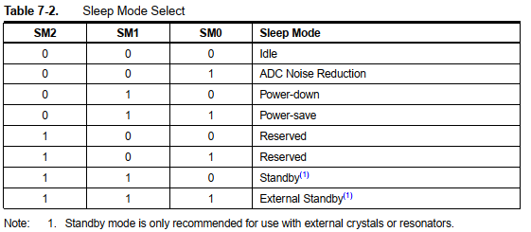
Register Description:

Slide 13

PRR: Power Reduction Register:
Bit 7 - PRTWI: Power Reduction TWI
Bit 6 - PRTIM2: Power Reduction Timer/Counter2
Bit 5 - PRTIM0: Power Reduction Timer/Counter0
Bit 4 - Res: Reserved bit
Bit 3 - PRTIM1: Power Reduction Timer/Counter1
Bit 2 - PRSPI: Power Reduction Serial Peripheral Interface
Bit 1 - PRUSART0: Power Reduction USART0
Bit 0 - PRADC: Power Reduction ADC
Notes:
Bit 7 - PRTWI: Power Reduction TWI Writing a logic one to this bit shuts down the TWI by stopping the clock to the module. When waking up the TWI again, the TWI should be re initialized to ensure proper operation. • Bit 6 - PRTIM2: Power Reduction Timer/Counter2 Writing a logic one to this bit shuts down the Timer/Counter2 module in synchronous mode (AS2 is 0). When the Timer/Counter2 is enabled, operation will continue like before the shutdown. • Bit 5 - PRTIM0: Power Reduction Timer/Counter0 Writing a logic one to this bit shuts down the Timer/Counter0 module. When the Timer/Counter0 is enabled, operation will continue like before the shutdown.
Bit 4 - Res: Reserved bit
This bit is reserved in ATmega48P/88P/168P/328P and will always read as zero.
• Bit 3 - PRTIM1: Power Reduction Timer/Counter1
Writing a logic one to this bit shuts down the Timer/Counter1 module. When the Timer/Counter1 is enabled, operation will continue like before the shutdown.
• Bit 2 - PRSPI: Power Reduction Serial Peripheral Interface
If using debugWIRE On-chip Debug System, this bit should not be written to one.
Writing a logic one to this bit shuts down the Serial Peripheral Interface by stopping the clock to the module. When waking up the SPI again, the SPI should be re initialized to ensure proper operation.
• Bit 1 - PRUSART0: Power Reduction USART0
Writing a logic one to this bit shuts down the USART (Universal Synchronous/Asynchronous Receiver/Transmitter- a microchip that facilitates communication through a computer's serial port using the RS-232C protocol) by stopping the clock to the module. When waking up the USART again, the USART should be re-initialized to ensure proper operation.
• Bit 0 - PRADC: Power Reduction ADC
Writing a logic one to this bit shuts down the ADC. The ADC must be disabled before shut down. The analog comparator cannot use the ADC input MUX when the ADC is shut down .

